Slide 1

Monkey Robotics
Allan Pead
Xamarin Premier Partner / Xamarin Insider
@adpead / apead@adsoftsystems.co.za

Slide 2
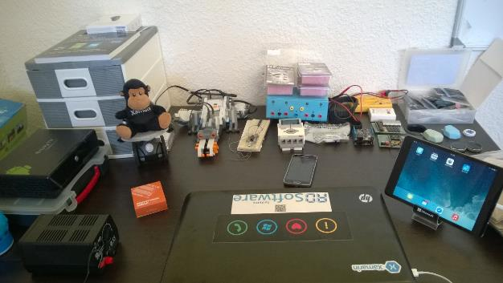
My Projects
RFDuino
Arduino
Netduino
Alarm Modules
Logging
Beacons
Oscilloscope
My Youtube Channel

Slide 3
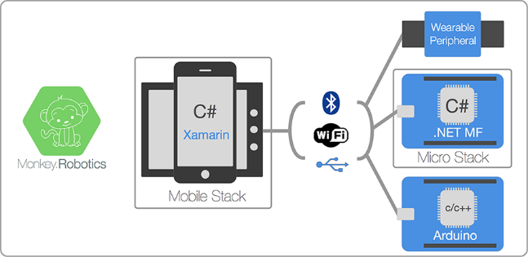
Monkey Robotics
Mobile Stack
Notes:
The Mobile stack consists of three different parts:
Low-level Bluetooth LE (BLE) API - A cross-platform API (iOS and Android only right now) that supports communicating with BLE devices.
Low-Level Wifi API - A cross-platform API (iOS and Android only right now) that supports connecting to WiFi enabled devices. Note that the WiFi API is still in progress.
Messaging Framework - A high-level cross-platform protocol for messaging peripherals via WiFi or BLE.
Peripheral Libraries - Strongly typed libraries for communicating with various vendor-specific peripherals such as health monitoring devices, smart watches, and the like.

Slide 4
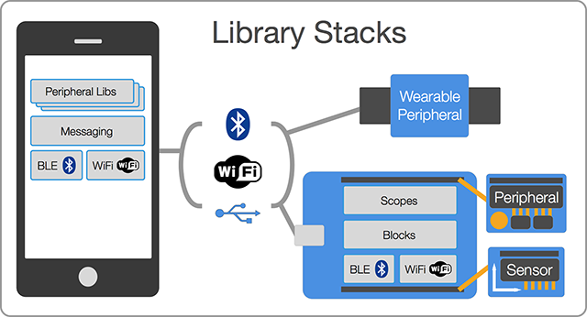
Monkey Robotics
Micro Stack
Notes:
The Microcontroller stack consists of two parts:
Low-level Hardware Abstraction - This is a modular/compositable based on the concept of Blocks and Scopes that represent devices and listeners, accordingly.
Sensor and Peripheral Library - Strongly typed libraries that do the heavy lifting of integration with hundreds of popular sensors spanning the gamut from Alcohol Sensors to 3-axis Accelerometers.

Slide 5
Monkey Robotics
Sensors - Sensors are peripherals that typically have outputs and are sometimes configurable. Sensors include buttons, light sensors, infrared distancing, accelerometers, compasses, temperature, etc.
Motors - These include not only the electric motors themselves, but also the drivers such as driver boards, and H-Bridges.
Generators - These are specialized blocks that generate signals. For example, there is a sine-wave generator, Pulse-width modulation (PWM) generator, constant generator, etc.
Scopes - Scopes are blocks that are meant to listen in on signals and do interesting things with the signal
Blocks

Slide 6
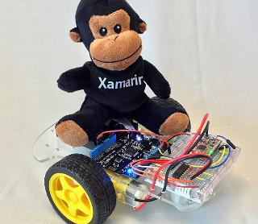
Monkey Robotics
Try it out
https://github.com/xamarin/Monkey.Robotics

